Slide 1

Notes:
1st slide (Mandatory)

Slide 2


Maximum sum of hour glass in matrix
The concept of finding the maximum sum of an hourglass in a matrix involves traversing the elements of the matrix and identifying hourglass patterns. An hourglass pattern refers to a specific arrangement of elements in the matrix that resembles the shape of an hourglass. Here's an example of an hourglass pattern:
```
a b c
d
e f g
```

Slide 3
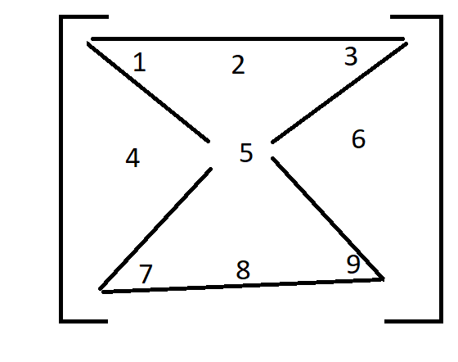
Sum = 1+2+3+5+7+8+9 =
35
Now What is Mean By Maximum Sum of Hour Glass?

Slide 4
3x3 has only 1 Hour glass but,
4x4 has 4 hour glass
for eg:
1 2 3 4
5 6 7 8
9 1 2 3
4 5 6 7
we have to find max sum of this 4 possibilities
sum1 =1+2+3+6+9+1+2 =24
sum2 =2+3+4+7+1+2+3 =22
sum3 =5+6+7+1+4+5+6 =34
sum4 =6+7+8+2+5+6+7 =41
so, Return 41 the maximum sum in the given 4x4 matrix

Slide 5
how to find number of possibilities?
we know that:
(R-2) (C-2)
can get 4x4= (4-2)(4-2) = 4

Slide 6
import java.util.Scanner;
public class Hourglass {
static int findMaxSum(int [][]mat,int R,int C)
{
int max_sum=0;
int sum;
if (R < 3 || C < 3){
System.out.println("Not possible");
System.exit(0);
}
for (int i = 0; i < R - 2; i++)
{
for (int j = 0; j < C - 2; j++)
{
sum = (mat[i][j] + mat[i][j + 1] +
mat[i][j + 2]) + (mat[i + 1][j + 1]) +
(mat[i + 2][j] + mat[i + 2][j + 1] +
mat[i + 2][j + 2]);
max_sum = Math.max(max_sum, sum);
}
}
return max_sum;
}

Slide 7
static public void main (String[] args)
{
Scanner sc = new Scanner(System.in);
int R = sc.nextInt();
int C= sc.nextInt();
int [][]mat = new int[R][C];
for (int i = 0; i < R; i++) {
for (int j = 0; j < C; j++) {
mat[i][j]= sc.nextInt();
}
}
int res = findMaxSum(mat,R,C);
System.out.println("Maximum sum of hour glass = "+ res);
}
}

Slide 8

THANK YOU

